Slide 1
Business Data Visualisation – Final Project
Rajashri.N
DBA17013

Slide 2
Business Case
Line of Business : Health care
Business Requirement : This case is aimed to analyze how to improve services and better utilize resources in a hospital.

Slide 3
Smart Goal
The goal of the project is to determine which facilities are to be improved to see service satisfaction increase by 15% for next month.

Slide 4
Scope
Project scope includes the following,
1.Deliver quality services at low costs.
2.Identify departments requiring more facilities.
3.Implement process improvements and increase productivity.

Slide 5
Stakeholders
Patients
Health Care providers
Government
Medical Professionals and Other Health Care facilitators.

Slide 6
Assumption
The analysis is done with an underlying assumptions,
The need to provide ever increasing quality patient care will continue.
Changing in customer volume and demographics will continue.
Diseases specific to seasonal changes are recurring.
Rising operating costs driven by government regulations and expanded capacity requirements will impact the financial viability of healthcare systems.

Slide 7
Visualisation
Tableau

Slide 8
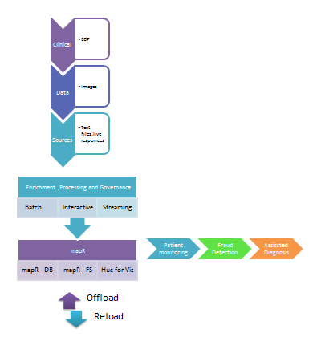
Architecture

Slide 9
KPI
1. Patient satisfaction & turn around
Business Requirement
To have reduced waiting times, high occupancy rate, Bed turnover rate, Care giver to patient ratio, staff quality.
2.Increase Revenue
Business Requirement
To increase revenue and reduce cost per procedure by improving claim accuracy and patient base retention.

Slide 10
KPI
3.Decrease waiting time
Business Requirement
To increase occupancy and decrease waiting time for out patients.
4.Decrease Readmission
Business Requirement
To have lower readmission rates for procedures that are life saving.

Slide 11
Thank you !!!!

